Slide 1
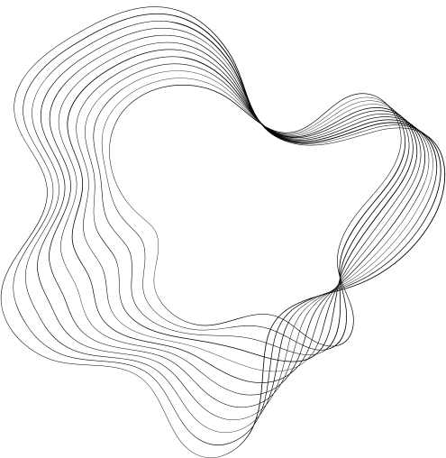
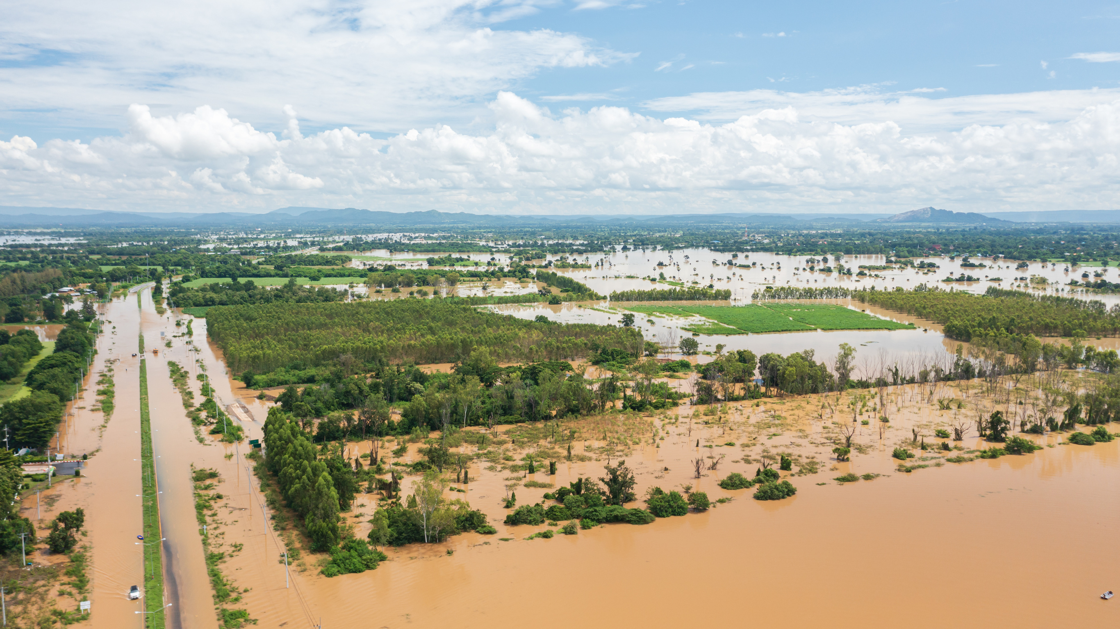
FLOOD
MONITORING

Slide 2
JAYAPRAKASH.S
au422621106016

Slide 3

DEFINATION
flood monitoring system is used to monitor a rise in water levels. The system comprises sensors that are deployed in cities or any area of interest. The sensors can be connected to either the main electricity or can be solar-powered.
It aims to monitor the water level and alert the authorities as well as notifying victims
order to do this, the system needs to have the basic information such as water conditions, water level and precipitation level to detect the increase of water level during flood.
Ultrasonic sensors play a vital role in the systems used for these purposes, which makes them important to flood preparedness. Need ultrasonic sensors for your flood monitoring and alert system

Slide 4
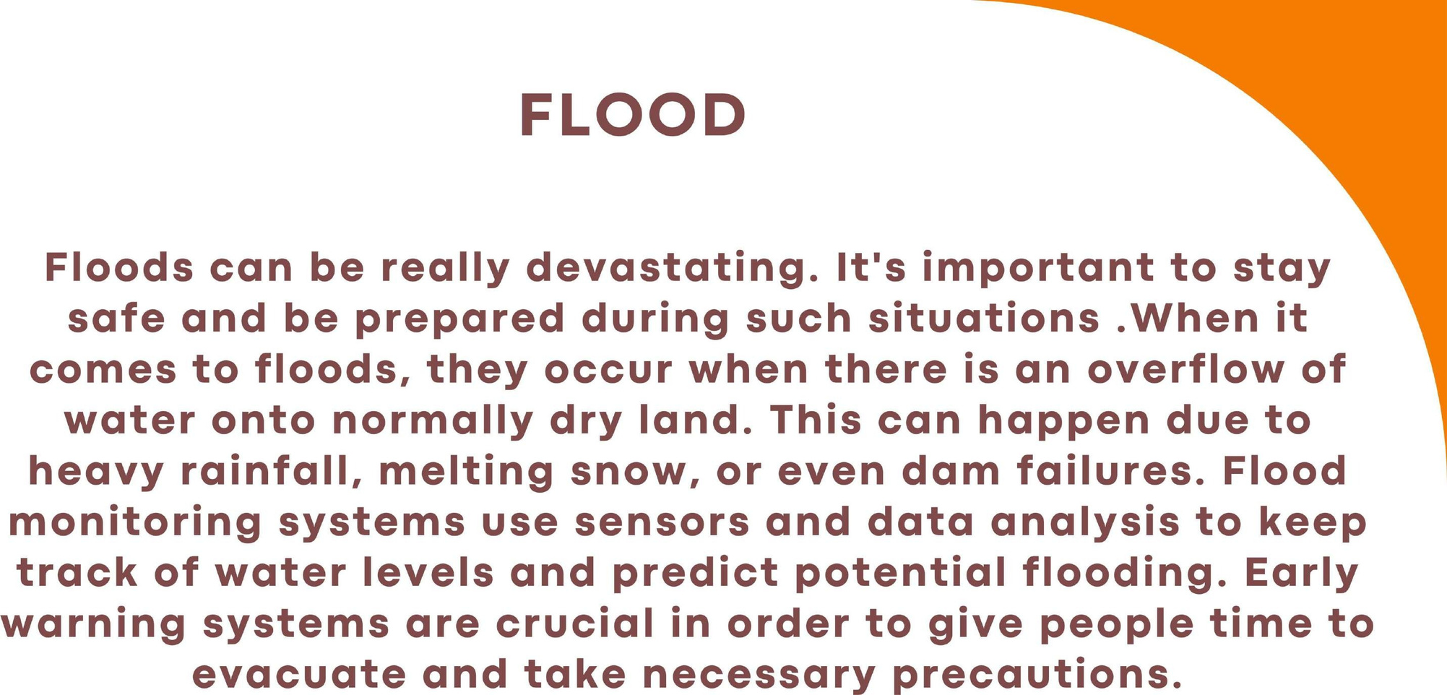

Slide 5
DESIGN THINKING
Project Objective Duties objects such as seal foot manting, arty waing munca, putne sutty and urgency response condition
jo Sensor Netwerk Dengan the plot of free to more vidro
Data of flood height and rain levels detected by sensors are processed using Arduino Uno Microcontroller to produce output data in HTML format.

Slide 6
This research produces a prototype of web-based flood monitoring information system that been able to distribute data of flood height and rainy weather in real time
the implementation of measurement, the information system only accesses one flood detector or one flooded location.
System prototype is the first development that uses internet of things (IoTs) method in real time web-based flood measurement with information in the form of flood hazard information in the form of water level and rainy weather conditions.

Slide 7
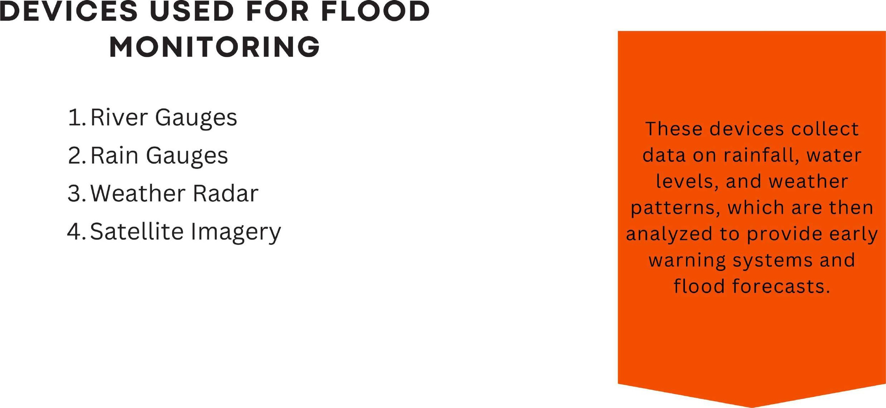

Slide 8
INNOVATION OF PROJECT
In this technology project you will continue building your project by developing the platform as per
project requirement. Use web development technologies wherever needed. After performing the
relevant activities create a document around it and share the same for assessment.

Slide 9
INTRODUCTION OF PROJECT
let's dive into flood monitoring! Flood monitoring is the process of collecting and analyzing data to assess and predict flood conditions. It involves monitoring various factors such as rainfall, river levels, and soil moisture to understand the potential for flooding. This data is collected through sensors and gauges placed in strategic locations. By continuously monitoring these parameters, authorities can issue timely warnings and take necessary actions to mitigate the impact of floods. Flood monitoring plays a crucial role in ensuring the safety of communities and minimizing damage caused by flooding. Let me know if you have any specific questions or if there's anything else I can assist you with.

Slide 10
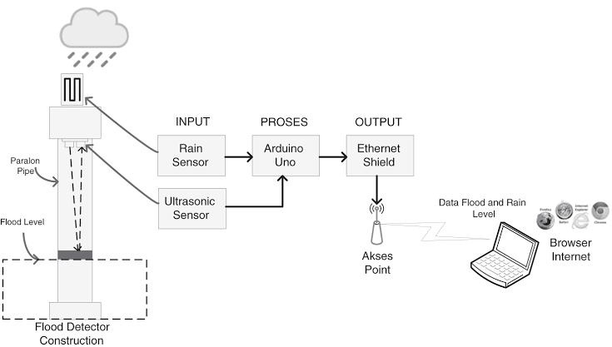
FLOOD MONITORING CIRCUIT

Slide 11
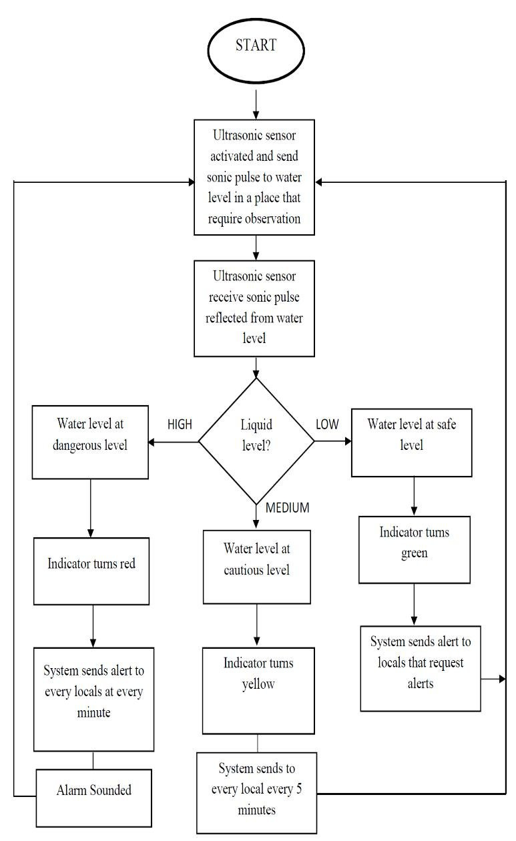
FLOW CHART

Slide 12
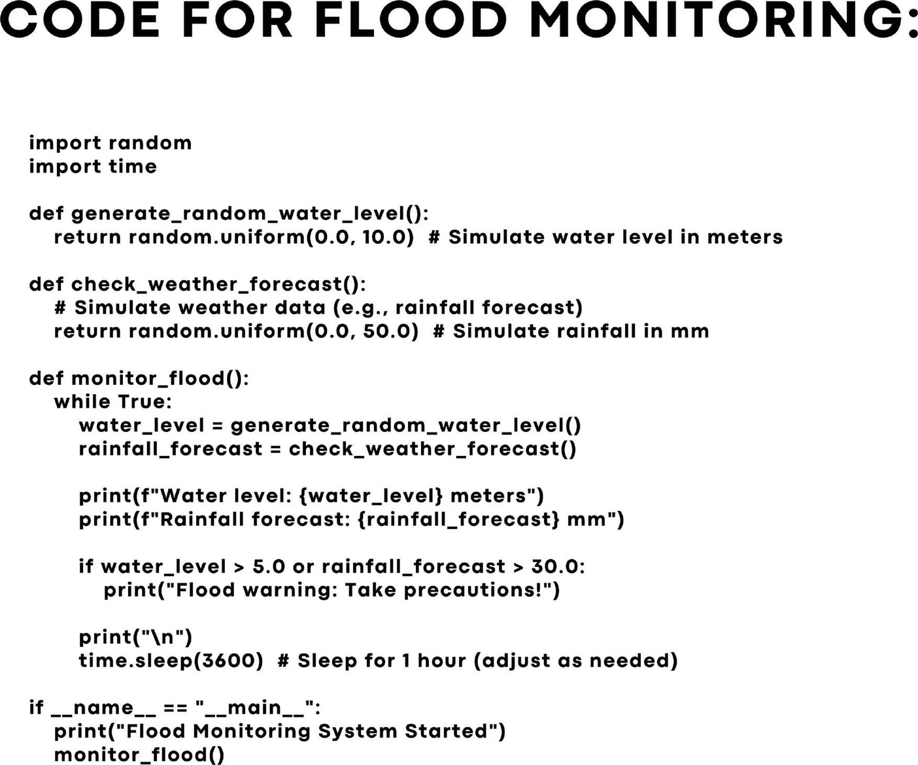

Slide 13
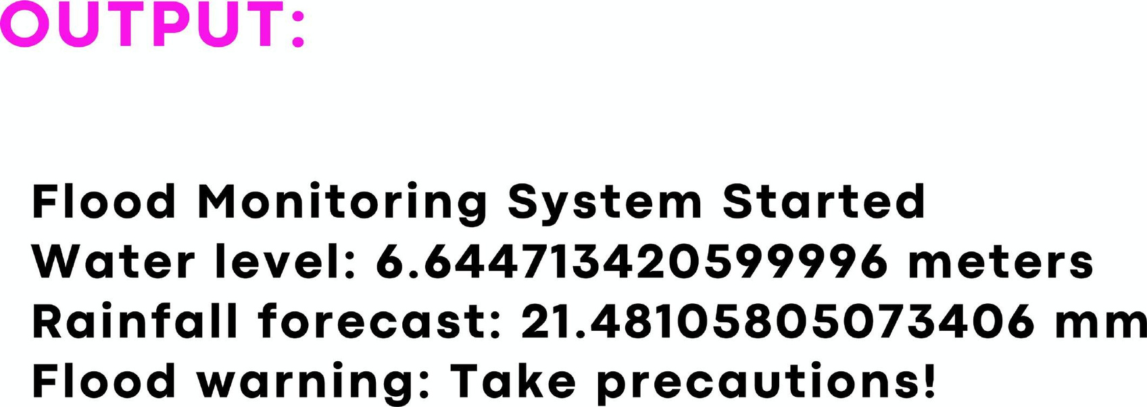

Slide 14
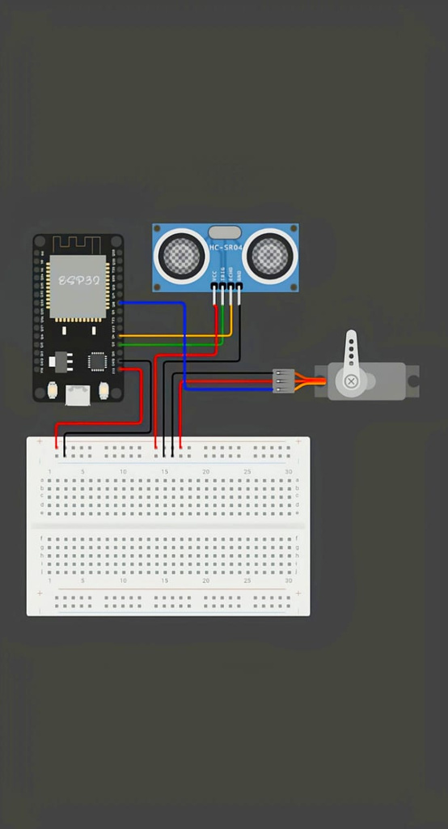
PROTOTYPE:

Slide 15
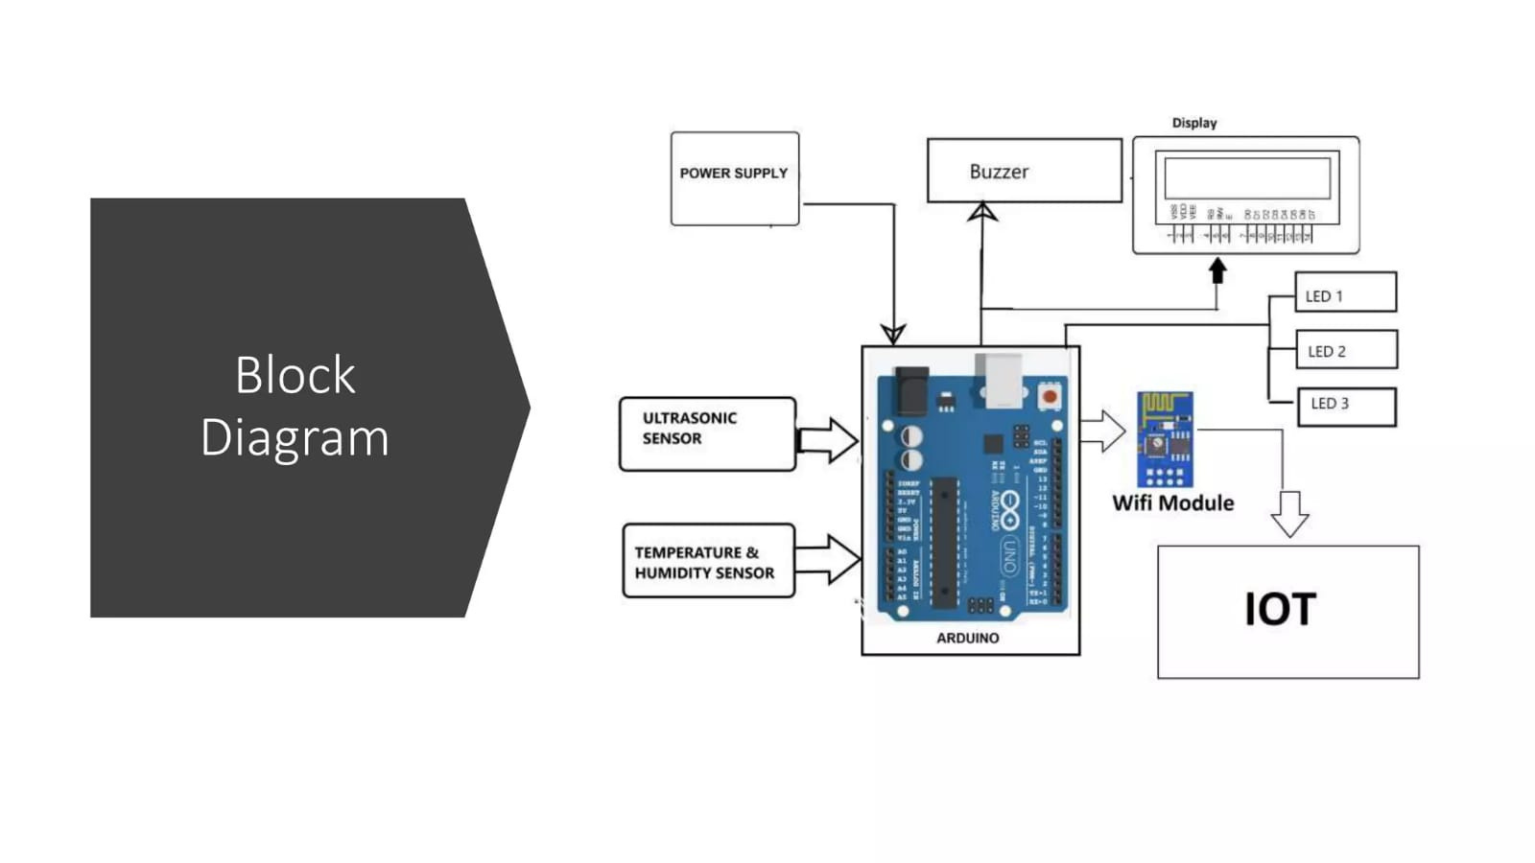

Slide 16

CONCLUSION
In conclusion, flood monitoring is a critical process that involves collecting and analyzing data on factors like rainfall, river levels, and soil moisture to assess flood conditions. By monitoring these parameters, authorities can issue timely warnings and take necessary actions to mitigate the impact of floods. It plays a crucial role in ensuring the safety of communities and minimizing damage caused by flooding. If you have any more questions or need further information.

Slide 17


